Slide 1
There is More to Needles than Threading The Eye
Barbara Heath

Slide 2
You don’t know what you don’t know
INTRODUCTION History of Needles
Hand Sewing
Machine Sewing

Slide 3
The invention of the first hand sewing needles is difficult to pinpoint to a single inventor, as they emerged from various ancient civilizations across the globe, with the earliest evidence of bone needles found dating back over 50,000 years.

Slide 4
Needle making in Britain dates back circa 300 years. The first evidence of needle making in its more conventional form was to be found in various monasteries and ecclesiastical centres throughout the county. Bordesley Abbey, founded in 1156, about a mile north of Redditch, was probably the earliest foothold of our industry in the Redditch area.
..

Slide 5
THE HISTORY OF JOHN JAMES NEEDLES John James was formed in 1840 and registered in 1902. The name John James is synonymous with the very best of needle manufacture, quality and reliability. The John James brand of “Finest Quality Needles” continues to be recognised by needle crafters around the globe.

Slide 6
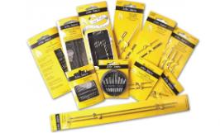
The original John James factory appeared listed as a business for the first time in an 1860 directory of the Redditch area.

Slide 7
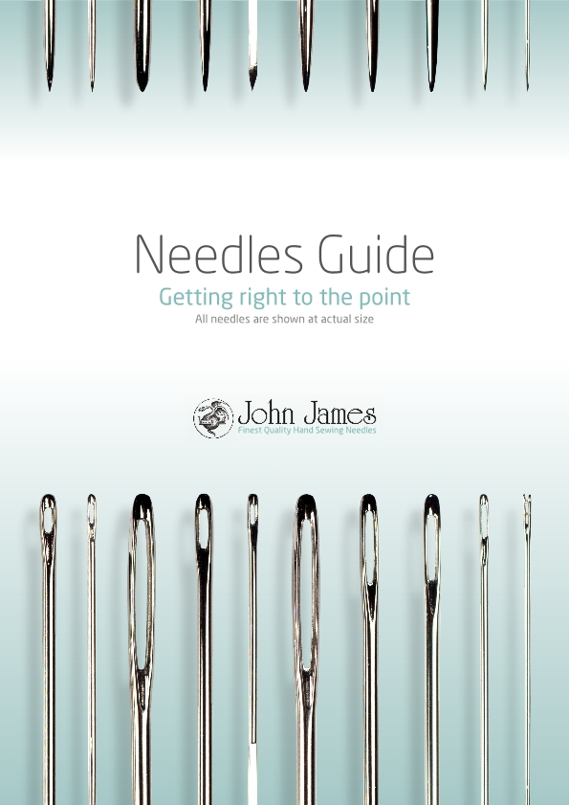
Included in your handout is a guide to understand which hand needle to use for different fabric types and application. There are needles for each application.
Visit the John James web site to print out an A4 sheet which gives you the actual sizes of the needle. There is a link on our website
A rule of thumb is the larger the number given to a needle, the smaller the eye and length.

Slide 8
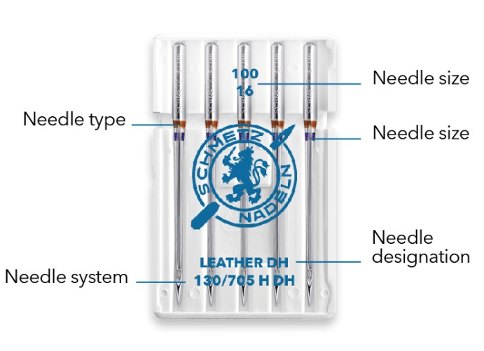
introduction
Your sewing machine is
only as good as the
needles you use!

Slide 9
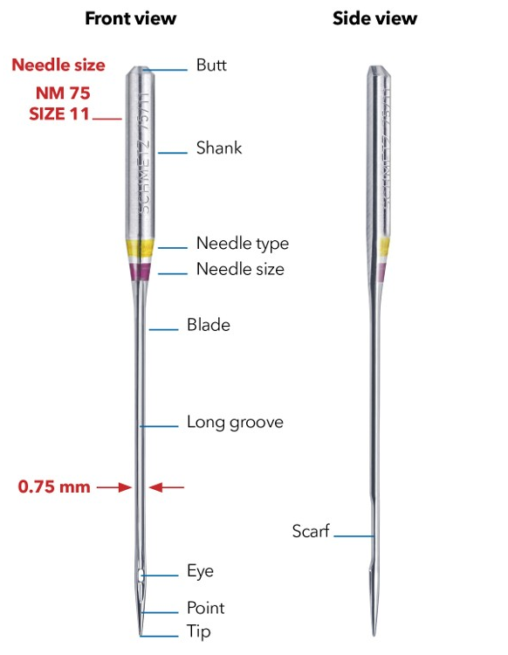
The top part of a sewing machine needle – the part that is inserted into the sewing machine’s needle bar – is known as the shank. Household sewing machine needles by SCHMETZ have a flat shank, which makes sure that the needle is always in the right position and cannot be inserted incorrectly. The butt of a SCHMETZ needle is also beveled, making the needle easier to insert into the needle bar. The color marking lets you know the type and size of the needle at a glance. The long groove protects the thread, ensuring that it does not get damaged during transportation through the fabric. The scarf creates more space for the hook so that the loop is easier to catch to form the stitch. The shape of the needle point and tip varies depending on the needle type. This makes sure the needle is always ideally suited to the material in question.
The NM number ( originally created by Singer)is the diameter of the needle blade multiplied by 100. A sewing machine needle with a blade diameter of 0.75 mm therefore corresponds to NM 75.

Slide 10
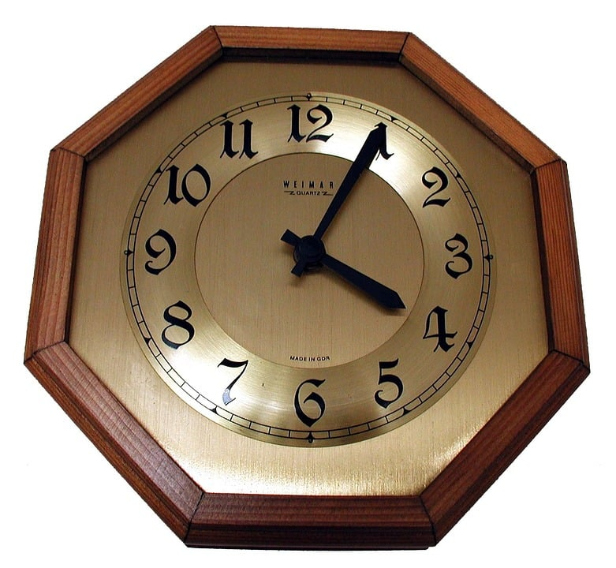
Replace your needle regularly!
This is the easiest way to improve seam quality.
Worn or damaged needles often lead to:
• Frayed threads or thread breakage
• Skipped stitches or uneven stitches
• Seam puckering
• Damaged textiles
• Popping sound during sewing
In addition, you can do a simple test to check
whether your needle is still in perfect condition:
Insert the needle into an old pair of sheer tights.
If it gets stuck or pulls on threads when piercing
or pulling out of the material, you should stop
using it as its point is damage
Rule of thumb
It is recommend that you replace
the needle after approx. 8 hours
of sewing time. Or, as an easy-to remember alternative: replace your
needle at the start of each new project

Slide 11
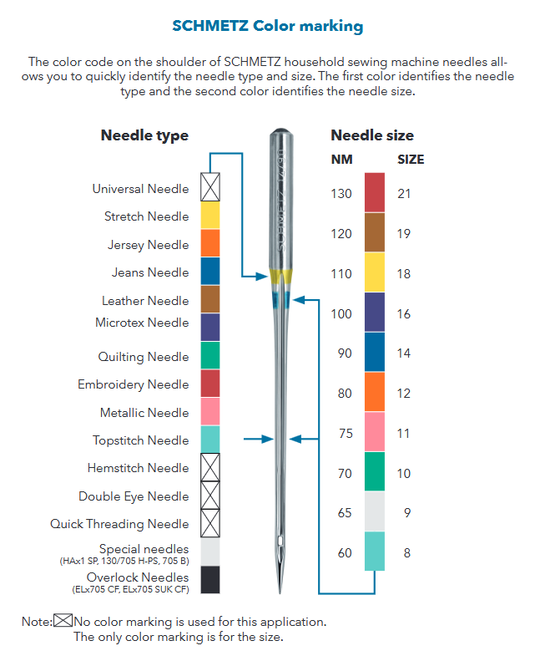

Slide 17
thank you
Barbara Heath
Acknowledgements
www.schmetz.com
www.jjneedles.com

